Slide 1
OOP Features and Execution of Java Program
Prepared By: Dimple Bohra

Slide 2
What is an Object?
The Object is the real-time entity having some state and behavior.
In Java, Object is an instance of the class having the instance variables like the state of the object and the methods as the behavior of the object.
The object of a class can be created by using the new keyword in Java Programming language.

Slide 3
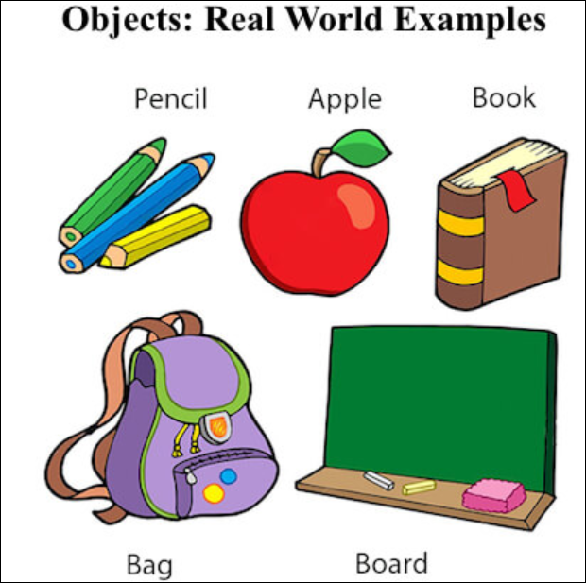

Slide 4
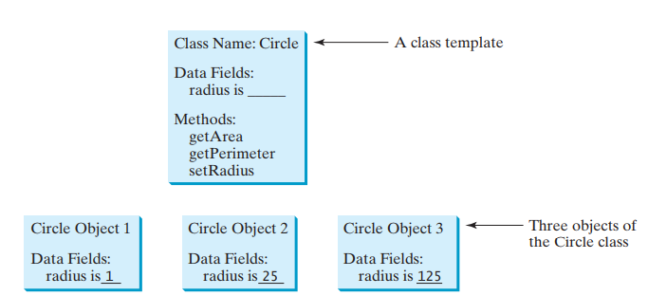
What is class?
A class is a group of objects which have common properties.
It is a template or blueprint from which objects are created.
In short, a class is the specification or template of an object.

Slide 5
OOP features
Abstraction
Encapsulation
Inheritance
Polymorphism

Slide 6

Abstraction
Abstraction means hiding lower-level details and exposing only the essential and relevant details to the users.
Notes:
The first example, let's consider a Car, which abstracts the internal details and exposes to the driver only those details that are relevant to the interaction of the driver with the Car.

Slide 7
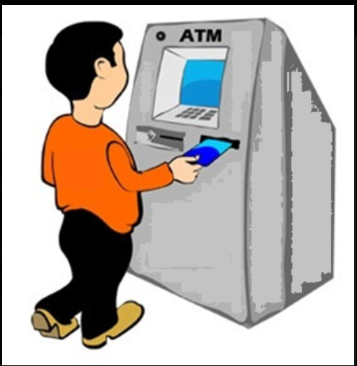
Example of Abstraction
Notes:
The second example, consider an ATM Machine; All are performing operations on the ATM machine like cash withdrawal, money transfer, retrieve mini-statement…etc. but we can't know internal details about ATM.

Slide 8
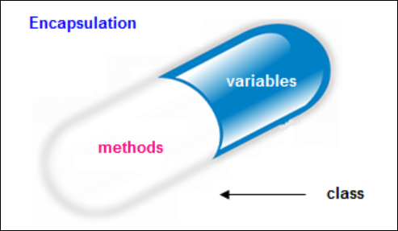
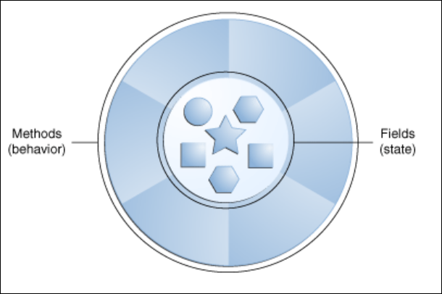
Encapsulation
Encapsulation is a process of wrapping of data and methods in a single unit is called encapsulation.
In OOP, data and methods operating on that data are combined to form a single unit, which is referred to as a Class.

Slide 9
Inheritance
The Inheritance is a process of obtaining the data members and methods from one class to another class, plus can have its own is known as inheritance.
Inheritance - IS-A relationship between a superclass and its subclasses.
Super Class: The class whose features are inherited is known as a superclass (or a base class or a parent class). Sub Class: The class that inherits the other class is known as a subclass(or a derived class, extended class, or child class). The subclass can add its own fields and methods in addition to the superclass fields and methods.

Slide 10
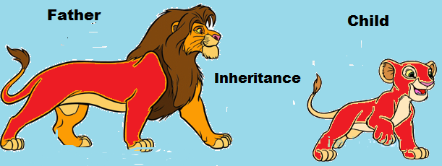
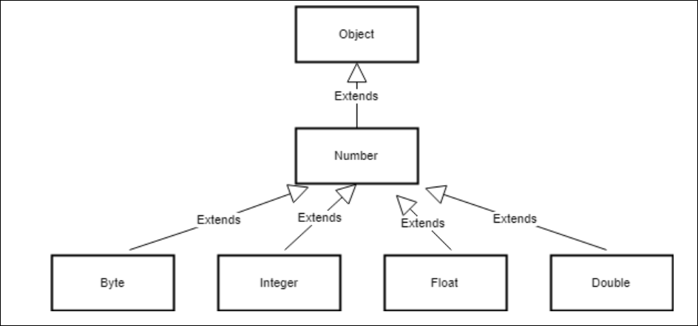
Notes:
In the Java library, you can see extensive use of inheritance. Below figure shows a partial inheritance hierarchy from a java.lang library. The Number class abstracts various numerical (reference) types such as Byte, Integer, Float, Double, Short, and BigDecimal.

Slide 11
Polymorphism
Polymorphism means many forms.
Different definitions of Polymorphism are:
Polymorphism let us perform a single action in different ways.
Polymorphism allows you to define one interface and have multiple implementations
We can create functions or reference variables which behaves differently in a different programmatic context.

Slide 12
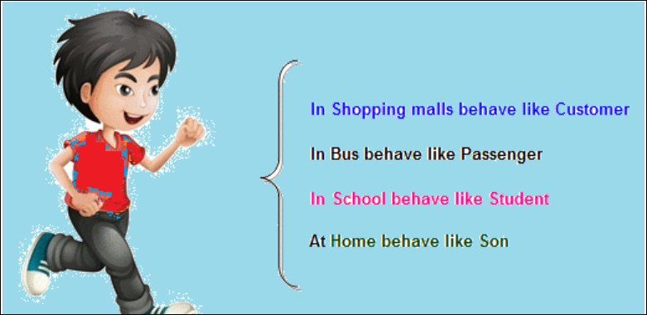
Example of Polymorphism

Slide 13
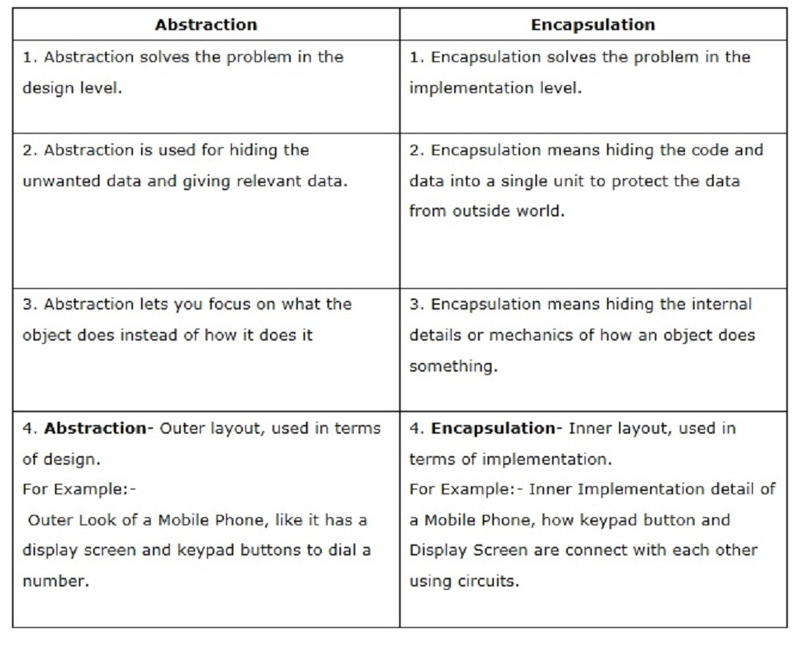

Slide 14
Steps of Executing Java Program
For executing any java program, you need to Install the JDK. If you don't have installed it, download and install it. https://www.oracle.com/java/technologies/javase-downloads.html Set path of the jdk/bin directory. Create the java program using notepad Compile and run the java program using javac and java command.

Slide 15
Set path
The path is required to be set for using tools such as javac, java, etc.
If you are saving the Java source file inside the JDK/bin directory, the path is not required to be set because all the tools will be available in the current directory.
However, if you have your Java file outside the JDK/bin folder, it is necessary to set the path of JDK.
We can set temporary as well as permanent path.

Slide 16
How to set the Temporary Path
To set the temporary path of JDK, you need to follow the following steps:
Open the command prompt
Copy the path of the JDK/bin directory
Write in command prompt: set path=copied_path
For Example:
set path=C:\Program Files\Java\jdk-14\bin

Slide 17
How to set Permanent Path
For setting the permanent path of JDK, you need to follow these steps:
Go to My Computer/ This PC - properties -> Advanced System Settings tab -> Environment variables -> new tab of user variable -> write path in variable name -> write path of bin folder in variable value -> ok -> ok - > ok

Slide 18
Structure of Java Program
class class-name
{
public static void main(String args[])
{
statement1;
statement2;
…
…
}
}

Slide 19
HelloWorld program
“First.java”
class First
{
public static void main(String args[])
{
System.out.println(“Hello World”);
}
}

Slide 20
Parameters used in First Java Program
class keyword is used to declare a class in java.
public keyword is an access modifier which represents visibility. It means it is visible to all.
static is a keyword. If we declare any method as static, it is known as the static method. The core advantage of the static method is that there is no need to create an object to invoke the static method. The main method is executed by the JVM, so it doesn't require to create an object to invoke the main method. So it saves memory.

Slide 21
Parameters used in First Java Program
void is the return type of the method. It means it doesn't return any value.
main represents the starting point of the program.
String[] args is used for command line argument. We will learn it later.
System.out.println() is used to print statement. Here, System is a class, out is the object of PrintStream class, println() is the method of PrintStream class. We will learn about the internal working of System.out.println statement later.

Slide 22
Naming Conventions
Class names should be nouns, in mixed case with the first letter of each internal word capitalized. Try to keep your class names simple and descriptive. Use whole words-avoid acronyms and abbreviations (unless the abbreviation is much more widely used than the long form, such as URL or HTML).
E.g. First, Sample, SimpleInterest etc.
Program names preferably should be same as class name.
E.g.First.java, Sample.java, SimpleInterest.java etc.

Slide 23
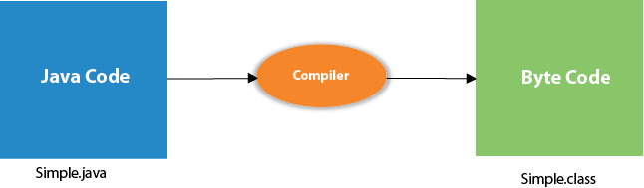
What happens at Compile time?
javac Simple.java
Notes:
Bytecode is a highly optimized set of instructions designed to be executed by the Java run-time system, which is called the Java Virtual Machine (JVM). In essence, the original JVM was designed as an interpreter for bytecode. This may come as a bit of a surprise since many modern languages are designed to be compiled into executable code because of performance concerns. However, the fact that a Java program is executed by the JVM helps solve the major problems associated with web-based programs. Here is why. Translating a Java program into bytecode makes it much easier to run a program in a wide variety of environments because only the JVM needs to be implemented for each platform. Once the run-time package exists for a given system, any Java program can run on it. Remember, although the details of the JVM will differ from platform to platform, all understand the same Java bytecode. If a Java program were compiled to native code, then different versions of the same program would have to exist for each type of CPU connected to the Internet. This is, of course, not a feasible solution. Thus, the execution of bytecode by the JVM is the easiest way to create truly portable programs.

Slide 24
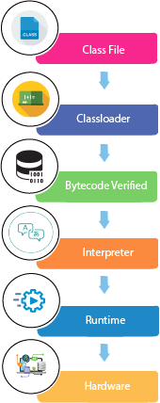
What happens at runtime?
Classloader: is the subsystem of JVM that is used to load class files.
Bytecode Verifier: checks the code fragments for illegal code that can violate access right to objects.
Interpreter: read bytecode stream then execute the instructions.

Slide 25
Execution process of Java program
Source Code
Byte Code
Object Code
compiler
JVM
javac First.java
Java First
First.class
OUTPUT
First.java

Slide 26
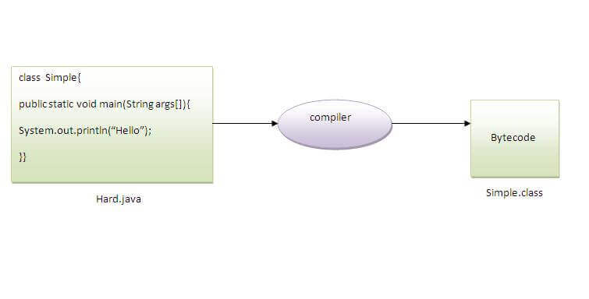
Can you save a java source file by other name than the class name?
→ Yes, if the class is not public.
To compile: | javac Hard.java
To execute: | java Simple

Slide 27
Java Virtual Machine (JVM)
JVM (Java Virtual Machine) is an abstract machine. It is called a virtual machine because it doesn't physically exist.
It is a specification that provides a runtime environment in which Java bytecode can be executed.
It can also run those programs which are written on other platforms and compiled to Java bytecode.
JVM, JRE, and JDK are platform dependent because the configuration of each OS is different from each other. However, Java is platform independent.
There are three notions of the JVM: specification, implementation, and instance.

Slide 28
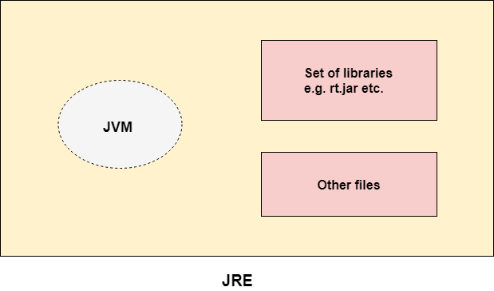
Java Run Time Environment (JRE)
The Java Runtime Environment is a set of software tools which are used for developing Java applications.
It is used to provide the runtime environment.
It is the implementation of JVM. It physically exists.
It contains a set of libraries plus other files that JVM uses at runtime.

Slide 29
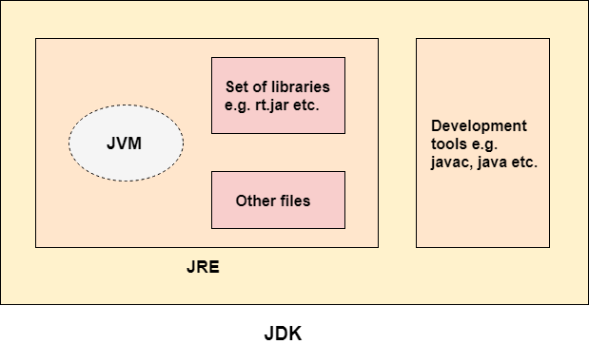
Java Development Kit (JDK)
The Java Development Kit (JDK) is a software development environment which is used to develop Java applications.
It physically exists. It contains JRE plus development tools.
The JDK contains a private Java Virtual Machine (JVM) and a few other resources such as an interpreter/loader (java), a compiler (javac), an archiver (jar), a documentation generator (Javadoc), etc. to complete the development of a Java Application.

Slide 30
HOME WORK
For those who are completely new to Java
Download and Install JAVA
SET permanent path to jdk/bin directory
WAP to print “WELCOME TO IT DEPARTMENT, VESIT”
For those who know basics of Java can write program for:
Take input from user through command prompt
Take input from user using Scanner class
Take input from user using BufferedReader class

